Slide 1

Data analysis Life cycle
Faith Ebhojiaye

Slide 2
Creating insights from Data Sources: Online and Manual
Daily summary by country of Sport betting company
Beauty contest Data
Mediamart Salary of Employee Data

Slide 3
Question to Answer
To be able to create insights from the Data
Mean, Median and Standard deviation

Slide 4
Purpose
To Know the Total revenue generated per country from the Sports and Casino and How to improve revenue generation
The contestant with the Highest score and the Judge that gave the highest score at the Beauty contestant
The Average salary of employees and the Total Amount Spent on Salaries by Mediamart

Slide 5
Variables Used for Insights
Mean
Median
Maximum Value
Minimum Value
Range
Standard deviation

Slide 6
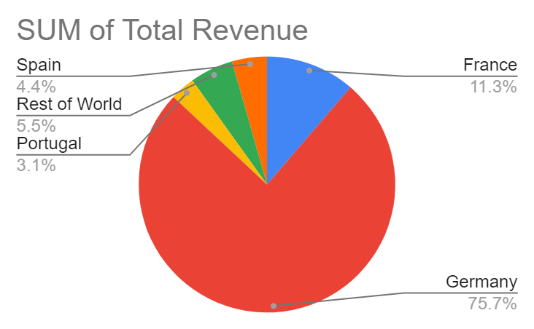
Total Revenue by Country

Slide 7
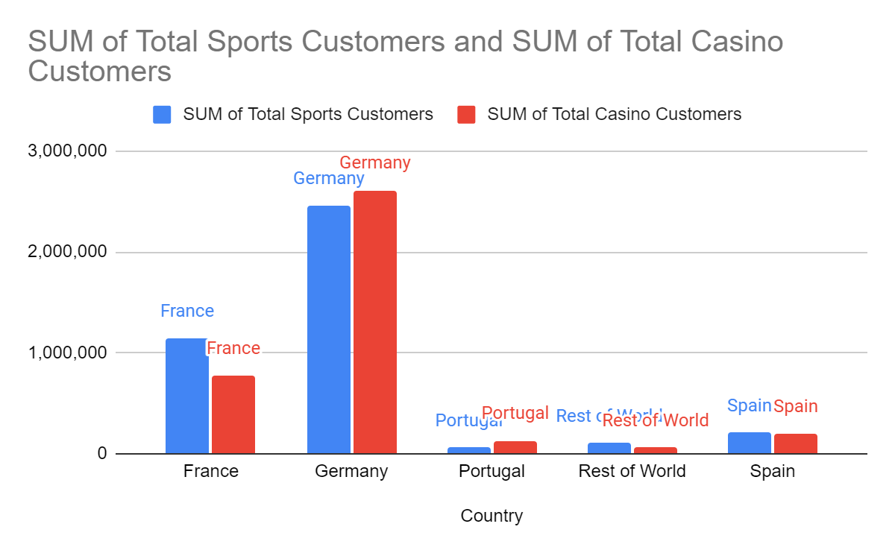
Total Customers for Sports and Casino

Slide 8
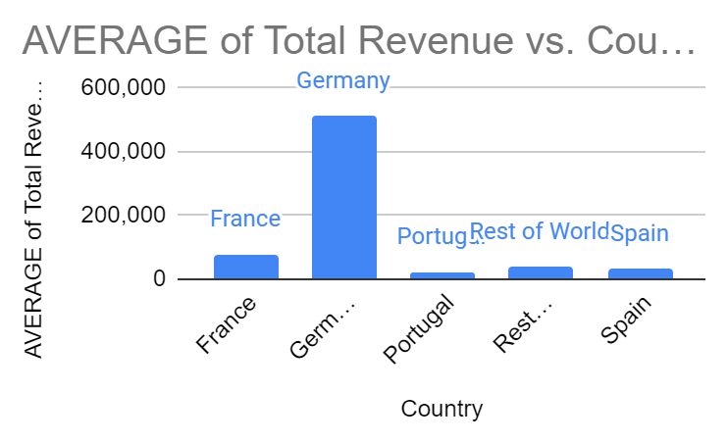

Slide 9
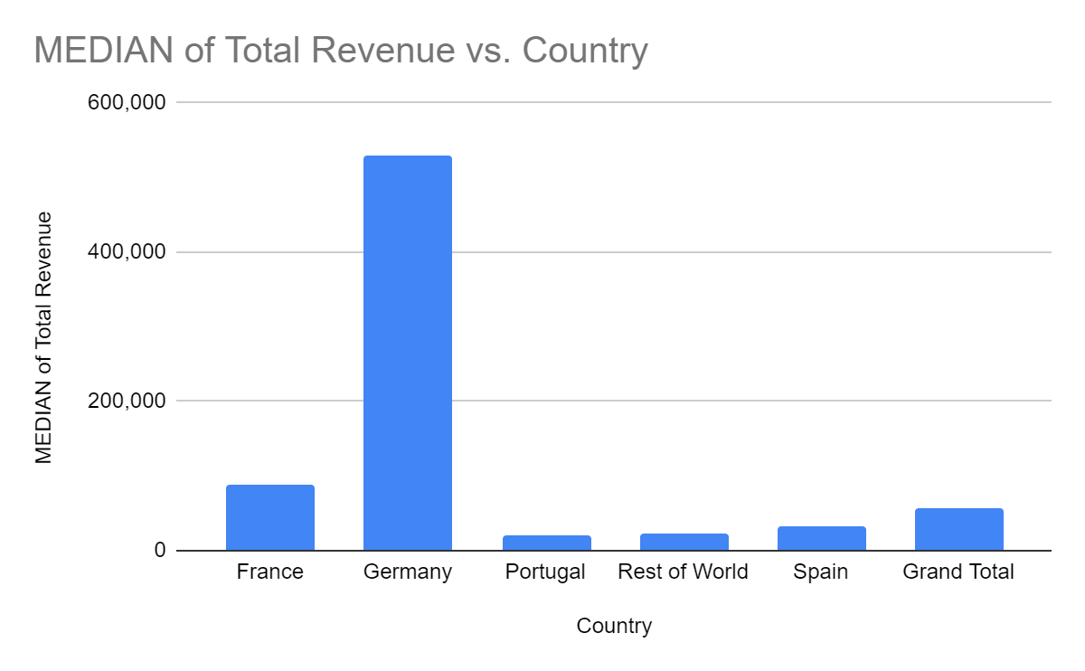

Slide 10
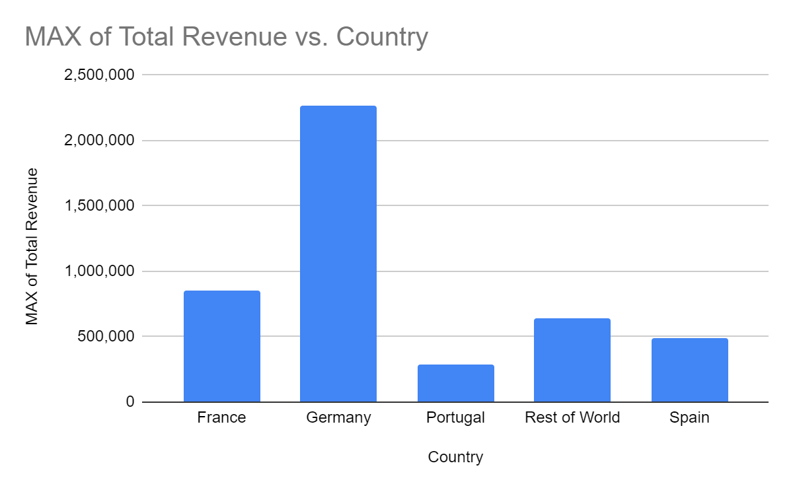

Slide 11
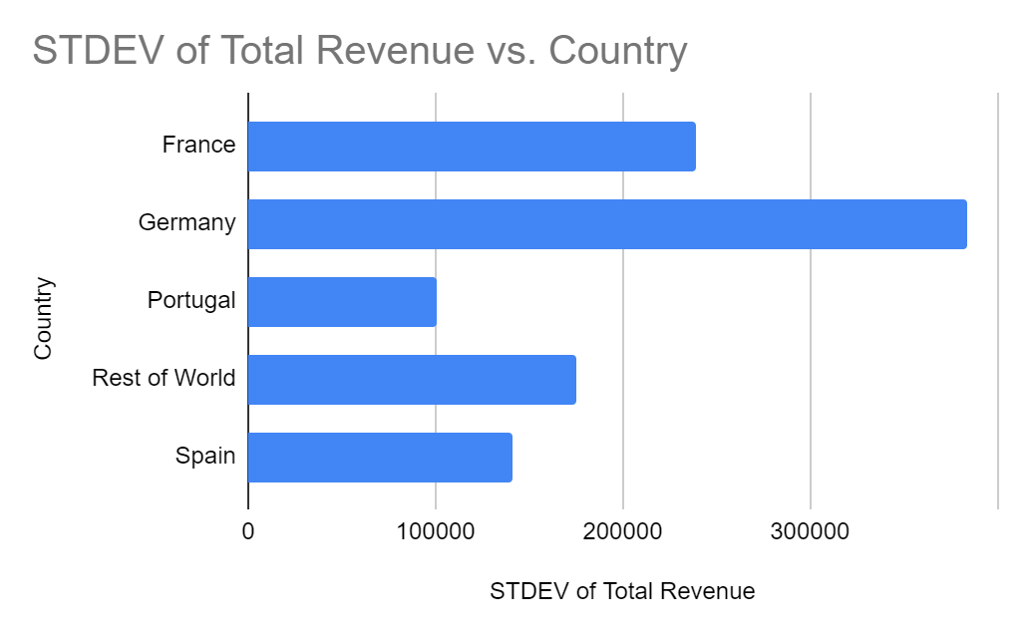

Slide 12
Analysis
From the Analysis, it shows that Germany generated more revenue in both the Casino and Sports customers. Less revenue was generated in Portugal and Spain.

Slide 13
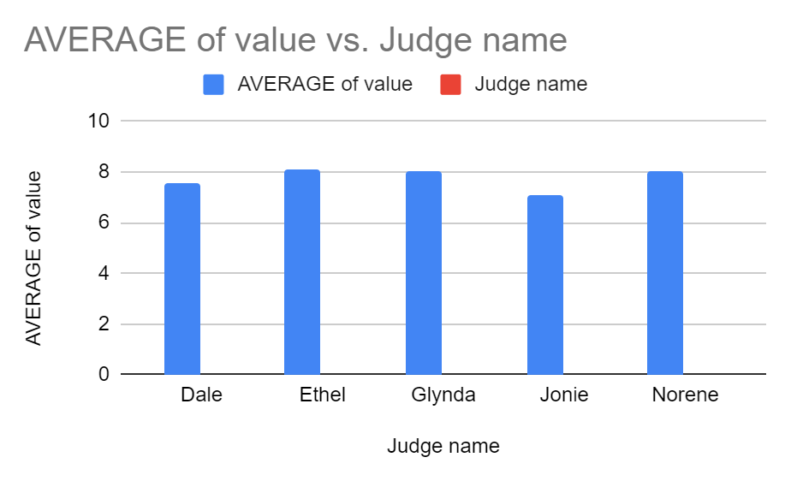

Slide 14
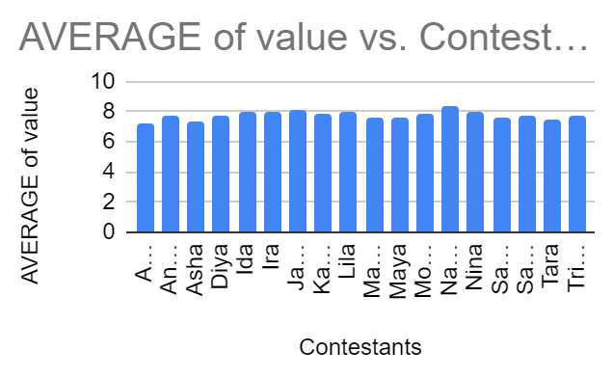

Slide 15
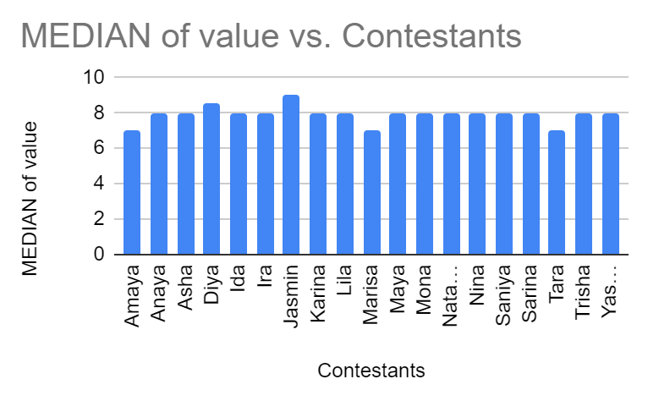

Slide 16
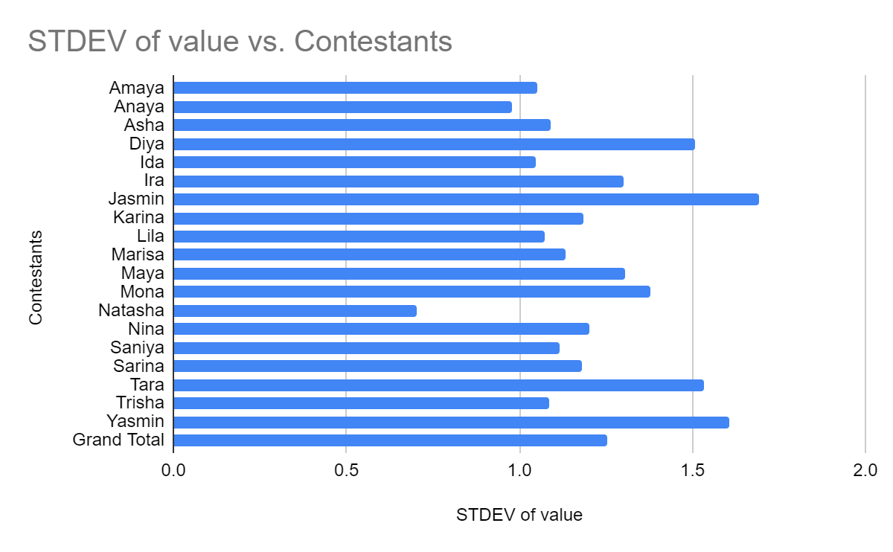

Slide 17
Salary of Employees of Mediamart
Average
54999.08163
Max
79078
Min
30585
Range
48493
Mid Range
24246.5
STD
14767.37473

Slide 18
Central Limit theorem
The probability distribution of the mean.
Calculated, the standard deviation how the data deviated from the mean

Slide 19
Conclusion
The company needs to find ways of generating revenue in countries like Portugal and Spain. Probably increasing Marketing in these countries.The countries with the lowest Sports and Casino revenue probably do not like sport betting
The Mean and Standard deviation are greatly affected by outliers.
Mean is easy and simple to calculate while the Standard deviation clearly shows the distribution of data around the mean

